Slide 1



Literature Review
Mental Health Chatbot
Presented by –
Juveriya Zameer

Slide 2
Agenda
01
Introduction
02
Business Problem
03
Research Goals
04
Applications
05
Data Collection
06
Data Pre-Processing
Development tools and techniques
07
08
Result and future work

Slide 3



Mental illness refers to a wide range of mental health conditions characterized by alterations in thinking and/or mood or behavior associated with distress and impaired functioning.
According to WHO, even before COVID crisis, depression affected over 300 million people
We have built “Therapist Bot” for mental health.
Natural treatment for mental health disorders without human connection and correction diagnosis is not possible
Mental health apps are not just hyped-up trend, instead they can complement traditional therapy when done right
Pandemic crisis taught us, mental health chatbots are much needed when there is no or limited access to traditional therapy.
Introduction

Slide 4
Business Problem
Access to mental health services is limited by long wait times, not knowing where to go for help,
shortage of accessible mental health professionals, and culture and language barriers
High cost of service which is usually not covered by private
insurance plans
People with Mental Health are reluctant to seek treatment, as the illness is often stigmatized.
In order to help such individuals various AI – powered health chatbots are introduced.
In 2018, an estimated 5.3 million of Canadians reported they needed help for their mental
health in the previous year. Of the 5.3 million people, 1.2 million had their need met
partially (22%) while 1.1 million had their need fully unmet (21%)

Slide 5
Research Goals
1. How effectively AI driven bots work in mental well-being?
2. How chatbots can serve as a high quality, cost-effective and accessible therapeutic agent?
3. How computational and artificial intelligence (AI) methods to be employed to supplement the support provided by moderators/clinicians?
4. Laws and regulations for use of chatbots do not exist and results in lack of privacy in users’ information.

Slide 6
Research Question 1: How effectively AI driven bots work in mental well-being?
Despite the growing popularity of conversational agents in other sectors, they are still rare in healthcare. (Laranjo et al., 2018)
Chatbots are artificial intelligence devices that can converse and communicate with humans in spoken, written, and visual languages (Abd-alrazaq et al., 2019).
(Skjuve et al., 2021) explained how they found Replika Chatbot to impact their mental wellbeing in a positive way.
(Skjuve et al., 2021) demonstrated that users had started taking better care of themselves, after chatbot Replika, urged them to get more sleep or begin practicing mindfulness strategies. (Skjuve et al., 2021)
The chatbot would become a therapeutic technology with features, such as easy accessibility, interactivity, and self-management. (Oh et al., 2020)
(Inkster et al., 2018) demonstrated that when compared with low Wysa users, high Wysa chatbot users experienced higher proportion of positive in-app experience and significantly higher average improvement in reduction of symptoms of major depression.
people(Ly et al., 2017) concluded that chatbot could mirror some therapeutic process, such as empathy and accountability. (Ly et al., 2017) They might ultimately be able to match patients with a high-quality, precisely timed personalized intervention.
(Ghandeharioun et al., 2019) emphasized that if interventions are more focused to specific moods and contexts , and are personalized then they have the potential to improve positive affect.

Slide 7
Research Question 2: How chatbots can serve as a high quality, cost-effective and accessible therapeutic agent?
(Oh et al., 2020) chatbots for mental wellbeing are easy to search and use. They are still a lot less expensive than face-to-face interventions (Denecke et al., 2020). Engaging with the app is free and available 24×7 (Inkster et al., 2018). Indirectly, automated interventions will save communities a lot of money (Ly et al., 2017)
Cost, reduction, improving efficiency and reduction of time spent asking questions to make the right diagnosis are some of the benefits of using conversational agents in healthcare (Cameron et al., 2017b)
Computer-assisted therapy and one conversational chatbot providing cognitive behavioral therapy (CBT) have been found in trials to be a less-intensive and more cost-effective recovery choice for depression and anxiety.(Fulmer et al., 2018).
For patients with mental disorder, smartphone app-based or immersive cognitive behavioral therapy using a chatbot is practical and effective(Oh et al., 2020). AI can serve as a cost-effective and accessible therapeutic agent(Fulmer et al., 2018)

Slide 8
Research Question 3
Chatbots would be crucial in advancing intervention priorities such as increasing consumer interaction, making it easier to identify and produce personalized counselling content, and fostering individuality, expertise, and relatedness. It can also be used to complement or substitute doctors or human moderators. (D’Alfonso et al., 2017)
Chatbots aren't intended to take on the role of a professional psychiatrist, but integrative therapeutic AI seems to be a promising choice for offering support(Fulmer et al., 2018)
How computational and artificial intelligence (AI) methods to be employed to supplement the support provided by moderators/clinicians?

Slide 9
Research Question 4
Recommendations around privacy are consistent with key policies produced by governments and non-government organizations that provide oversight of health apps. For example, according to the newly released EU General Data Protection Regulation, apps should save as little personal data as possible and strictly inform users about any data sharing with third parties. (Kretzschmar et al., 2019)
This means that people might rely on digital resources more and more as a substitute for mental health professional support, which highlights the importance of working hard to make these platforms effective and ethically responsible (Kretzschmar et al., 2019).
Laws and regulations for use of chatbots do not exist and results in lack of privacy in users’ information.

Slide 10
Applications of health chatbots
Woebot
Developed by graduate school students, it is an automated conversational chatbot the claims to monitor the mood of the user and provides a venue where user can express their thoughts and emotions through therapeutic conversations.
0
Moodkit and Moodnotes
MoodKit is developed by the company Thriveport, was recognized as the best app for depression in 2017. It is based on the CBT principles, and it helps users to alleviate symptoms of mental illness. This is done through guided activities that identify and change negative thought patterns, tools that rate and chart moods across time.
Pacifica
Pacifica app is developed by Pacifica Labs, Inc which helps user to address anxiety issues based on Cognitive Behavioral Therapy- based principles. Tools and activities includes meditation, relaxation, mood and health tracking tools.
Wysa
Developed in collaboration with the researchers from Columbia and Cambridge universities, Wysa is an ‘emotionally intelligent’ bot which helps users manage their emotions through an array of tools and techniques such as evidence based CBT, DBT ( Dialectical Behavior therapy)

Slide 11
Data Collection
We scraped data from https://counselchat.com/
The data contain responses from 307 therapist
Counselchat.com is a platform for counselors to build connection with potential clients.
Verified therapists posting the responses
The scraped data contains 31 topics which includes depression, stress, anxiety, military issues etc.

Slide 12
Pre Processing
Special characters & symbols - are non-alphanumeric characters or even occasionally numeric characters. They add noise to unstructured text data
Contractions - pose a problem for NLP &text analytics. Contractions are shortened versions of words or syllables. Example : "ain't": "is not"
Case conversion - A body of text is converted completely to lowercase or uppercase. Example : To avoid character & Character to be considered separate items
Stopwords - Stop words or filler words are words that have little or significant value to the analysis.
Tokenization - Process of turning corpus into sequences of tokens. A straightforward & effective tokenization strategy is to use white space & punctuation as token delimiters
Stemming - Process of mapping each token generated into its root form. Stemming leads to accuracy improvements by shrinking the number of dimensions used by the algorithms.
Post Tagging - POS are specific lexical categories to which words are assigned based on their syntactic context & role. Main POS: Nouns, Verbs, Adjectives & Adverbs

Slide 13
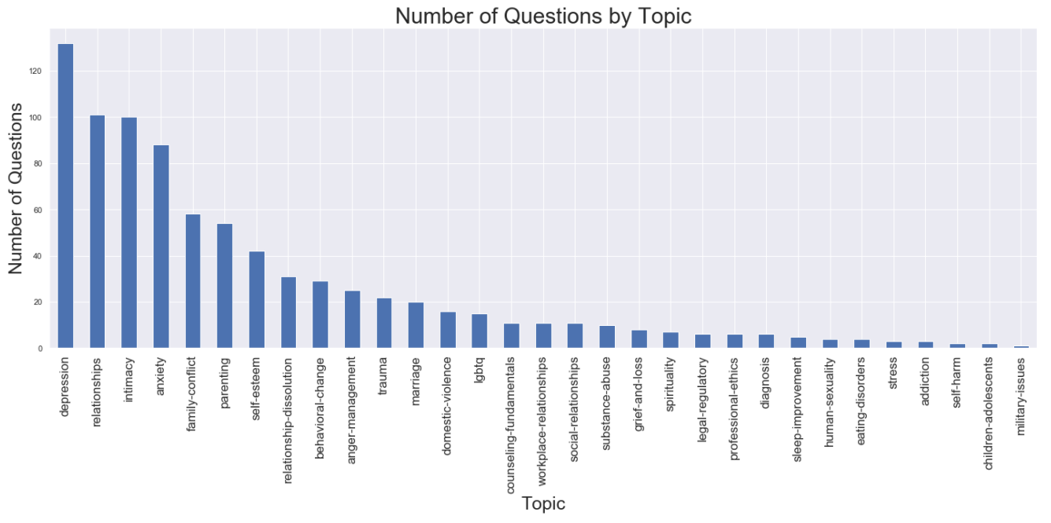
Data Visualization

Slide 14
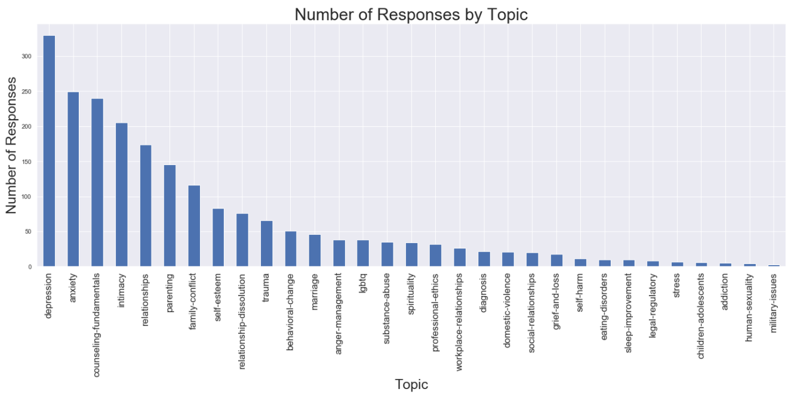

Slide 15
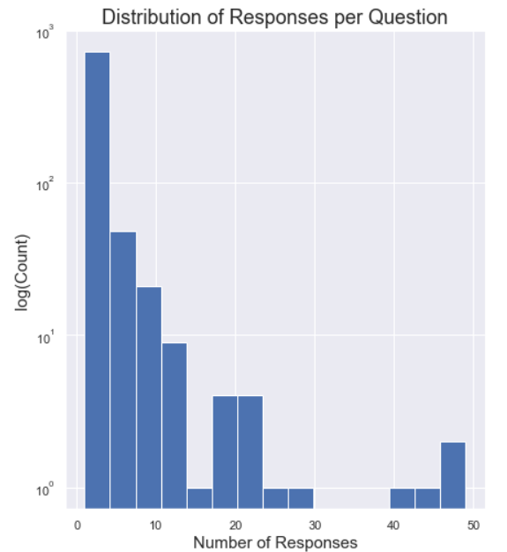
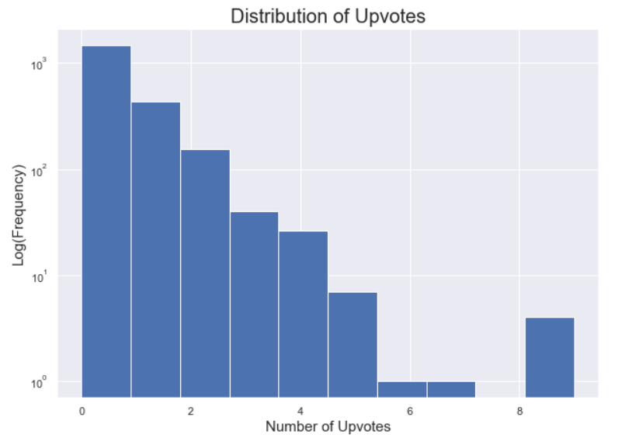

Slide 16
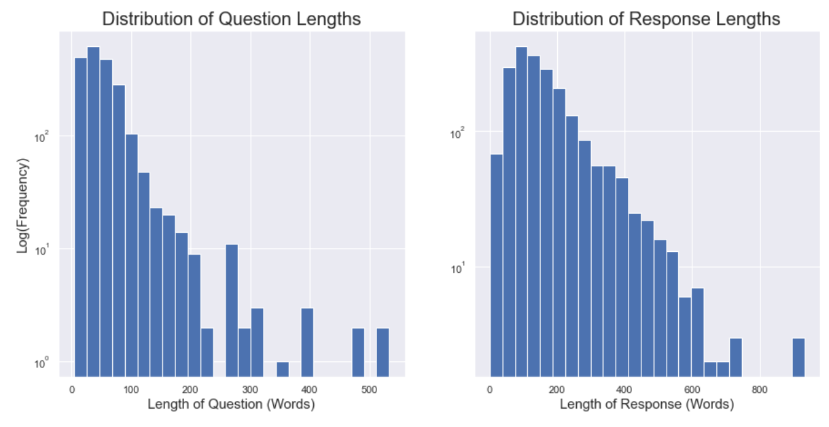
Questions Vs Response

Slide 17
COSINE SIMILARITY
Similarity is a metric that compares the similarity of two document vectors, regardless of their size. Many algorithms, such as information retrieval and recommender systems, depend on it. It is fundamentally linked to distance measurements between two documents.

Slide 18
Development Tools & Techniques

Slide 19
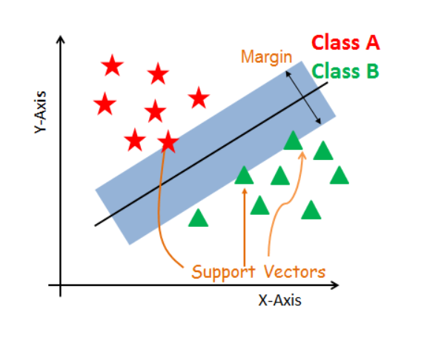
SVM Classifier :
TF-IDF is an abbreviation for Term Frequency Inverse Document Frequency. This is very common algorithm to transform text into a meaningful representation of numbers which is used to fit machine algorithm for prediction.
SVM offers very high accuracy compared to other classifiers such as Logistic regression and decision tree.
SVM classifier separates data points using a hyperplane with largest amount of margin and hence known as discriminative classifier.
SVM constructs hyperplane in multidimensional space.
The core idea is to find a maximum marginal hyperplane(MMH)
that best divides the dataset into classes.

Slide 20
BERT
‘BERT’ stands for Bidirectional Encoder Representations from Transformers.
Designed to pre-train deep bidirectional representations from unlabeled text by joining conditioning on both left and right context
Pre-trained BERT model can be fine-tuned with just one additional output layer to create state-of-the-art models for a wide range of NLP tasks
BERT_large, with 345 million parameters, is the largest model of its kind.
It combines Mask Language Model (MLM) and Next Sentence Prediction (NSP).
COMBINED
TF-IFD + SVM + BERT

Slide 21
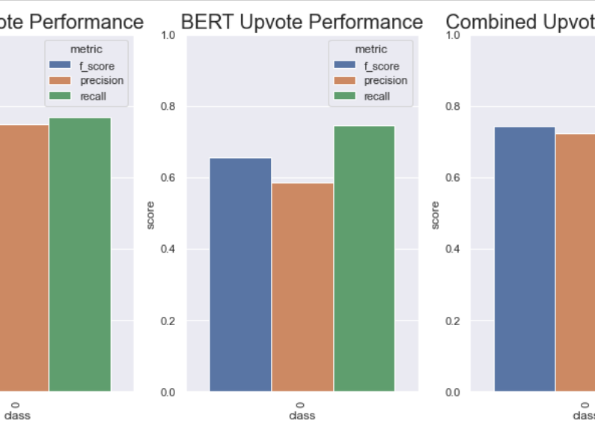
TF-IDF vs BERT vs Combined

Slide 22
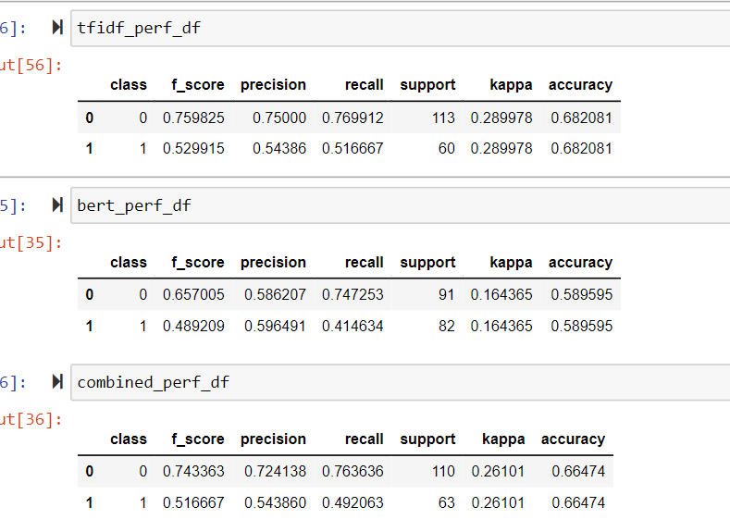
Accuracy Vs F_Score Vs Recall

Slide 23
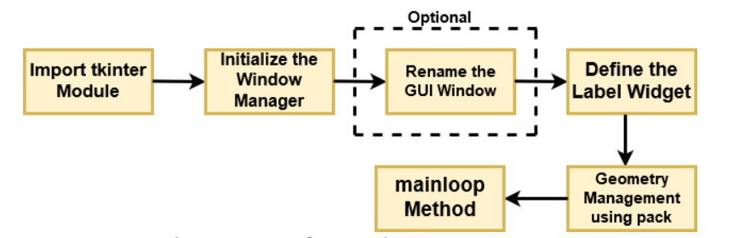
GUI using Tkinter
We Create
Quality Professional
PPT Presentation
Example Text :
Get a modern PowerPoint Presentation that is beautifully designed. You can simply impress your audience and add a unique zing and appeal to your Presentations. Easy to change colors, photos and Text. I hope and I believe that this Template will your Time, Money and Reputation. I hope and I believe that this Template will your Time, Money and Reputation. Easy to change colors, photos and Text. I hope and I believe that this Template will your Time, Money and Reputation.
Tkinter comes bundled with Python
Tk is Python’s standard GUI framework
It is open source and is known for its simplicity and graphical user interface
Get a modern PowerPoint Presentation that is beautifully designed. I hope and I believe that this Template will your Time, Money and Reputation. You can simply impress your audience and add a unique zing and appeal to your Presentations. Get a modern PowerPoint Presentation that is beautifully designed. You can simply impress your audience and add a unique zing and appeal to your Presentations. Easy to change colors, photos and Text. I hope and I believe that this Template will your Time, Money and Reputation. I hope and I believe that this Template will your Time, Money and Reputation. Easy to change colors, photos and Text.
I hope and I believe that this Template will your Time, Money and Reputation.
Example Text :
Get a modern PowerPoint Presentation that is beautifully designed. You can simply impress your audience and add a unique zing and appeal to your Presentations. Easy to change colors, photos and Text. I hope and I believe that this Template will your Time, Money and Reputation. I hope and I believe that this Template will your Time, Money and Reputation. Easy to change colors, photos and Text. I hope and I believe that this Template will your Time, Money and Reputation.
Fig : Flow diagram for building GUI using Tk

Slide 24
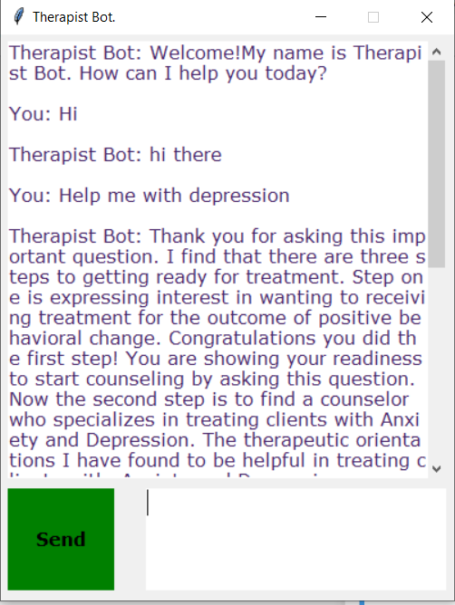
Result…

Slide 25
Future work:
Train Bot on deep learning models using LSTM’s and Transformers.
Therapist Bot

Slide 26
References:
Ghandeharioun, A., McDuff, D., Czerwinski, M., & Rowan, K. (2019). EMMA: An Emotion-Aware Wellbeing Chatbot. 2019 8th International Conference on Affective Computing and Intelligent Interaction, ACII 2019, 15–21. https://doi.org/10.1109/ACII.2019.8925455
https://towardsdatascience.com/counsel-chat-bootstrapping-high-quality-therapy-data-971b419f33da
https://www-sciencedirect-com.proxy.bib.uottawa.ca/science/article/pii/S0022395620311602?via%3Dihub
https://journals.sagepub.com/doi/full/10.1177/0840470420933911
https://www.datacamp.com/community/tutorials/svm-classification-scikit-learn-python
https://www.analyticsvidhya.com/blog/2019/09/demystifying-bert-groundbreaking-nlp-framework/
Laranjo, L., Dunn, A. G., Tong, H. L., Kocaballi, A. B., Chen, J., Bashir, R., Surian, D., Gallego, B., Magrabi, F., Lau, A. Y. S., & Coiera, E. (2018). Conversational agents in healthcare: a systematic review. Journal of the American Medical Informatics Association, 25(7), 248–258. https://doi.org/10.1093/jamia/ocy072
Abd-alrazaq, A. A., Alajlani, M., Alalwan, A. A., Bewick, B. M., Gardner, P., & Househ, M. (2019). An overview of the features of chatbots in mental health: A scoping review. International Journal of Medical Informatics, 132(11), 180–232. https://doi.org/10.1016/j.ijmedinf.2019.103978
Skjuve, M., Følstad, A., Fostervold, K. I., & Brandtzaeg, P. B. (2021). My Chatbot Companion - a Study of Human-Chatbot Relationships. International Journal of Human-Computer Studies, 149(4), 34–50. https://doi.org/10.1016/j.ijhcs.2021.102601
Oh, J., Jang, S., Kim, H., & Kim, J.-J. (2020). Efficacy of mobile app-based interactive cognitive behavioral therapy using a chatbot for panic disorder. International Journal of Medical Informatics, 140(9), 67–95. https://doi.org/10.1016/j.ijmedinf.2020.104171
Inkster, B., Sarda, S., & Subramanian, V. (2018). An Empathy-Driven, Conversational Artificial Intelligence Agent (Wysa) for Digital Mental Well-Being: Real-World Data Evaluation Mixed-Methods Study. JMIR MHealth and UHealth, 6(11), 112–132. https://doi.org/10.2196/12106
Ly, K. H., Ly, A.-M., & Andersson, G. (2017). A fully automated conversational agent for promoting mental well-being: A pilot RCT using mixed methods. Internet Interventions, 10(7), 39–46. https://doi.org/10.1016/j.invent.2017.10.002

Slide 27
Thank you !

